Slide 1
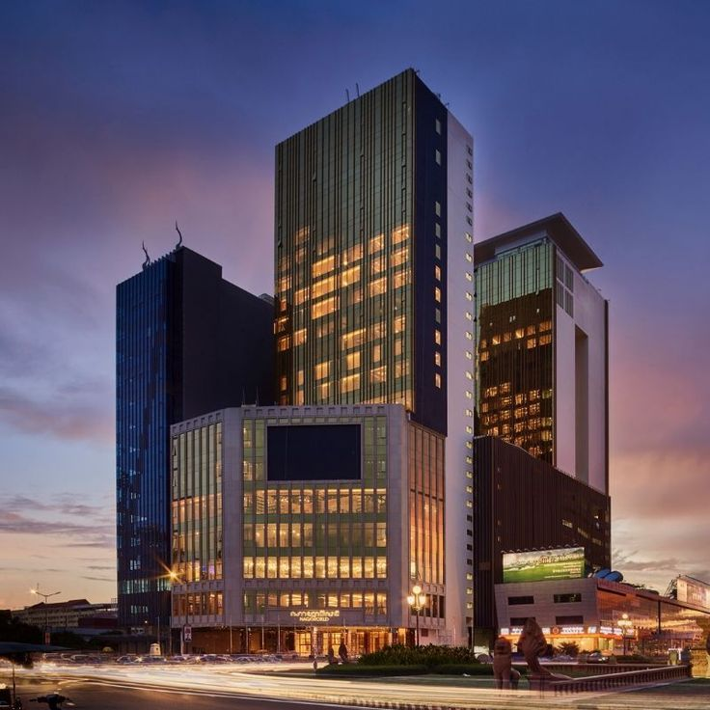

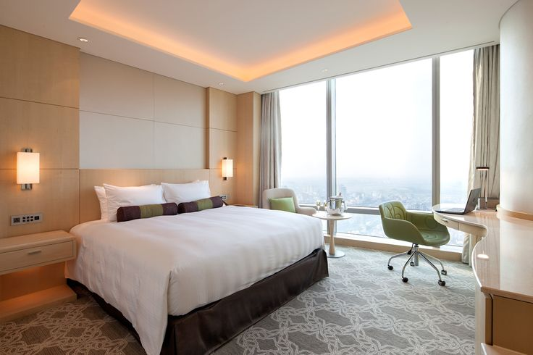

HOTEL BOOKING ANALYSIS
Sujata Kumari

Slide 2
Objectives
Understand Guest Behavior: Analyze guest demographics, preferences, and behaviors to identify key trends and patterns in hotel bookings.
Study Booking Influencers: Examine factors affecting bookings such as seasonal demand, market segmentation, and operational challenges (e.g., cancellations and special requests).
Analyze Key Booking Elements: Investigate booking sources, reservation statuses, room preferences, meal plans, and other guest characteristics.
Improve Customer Satisfaction: Identify strategies to better meet guest needs and expectations.
Reduce Cancellations: Discover patterns that lead to cancellations and suggest methods to minimize them.
Optimize Revenue Streams: Find opportunities to maximize average daily rates (ADR), upsell services, and improve overall profitability.
Enhance Operational Efficiency: Provide insights that help streamline hotel operations and resource allocation.
Support Strategic Decision-Making: Enable data-driven decisions for marketing, service design, and revenue management.
Develop a Guest-Centric Approach: Help hotels offer personalized services by understanding the interplay between guest preferences and operational constraints.

Slide 3
Data Dictionary
Table – booking_details
Fields:
hotel : the type of hotel (categorical),
(categories: Resort Hotel, city Hotel)
is_canceled : Whether the booking was cancelled or not (binary),
{Values: 1 (cancelled) 0(not cancelled)}
Lead_time : The number of days between booking and arrival (numerical)
arrived_date_year : The year of arrival (numerical)
arrival_date_ month : The month of arrival (Categorical),
(Categories: January, February, ..., Dec.)
arrival_date_week_number : The week number of the arrival date (numerical)
arrival_date_day_of_month : The day of the month arrival (numerical)
Stay_in_weekend_nights : The number of weekend nights (numerical)
Stay_in_week_nights : The number of weekdays nights (numerical)
country : The country of origin (categorical)
Booking_id : unique id of guest (numerical)

Slide 4
Table – guest_info
Fields:
adults : Number of adults (numerical)
children : Number of children (numerical)
babies : Num. of babies (numerical)
Table – meal_and_stay_details
Fields:
meal : Type of meal booked (Categorical),
(Categories: BB (Bed & Breakfast), HB (Half Board), FB(Full Board),
SC (self catering))
adr : Average Daily Rate (numerical)
required_car_Parking_spaces : No. of car parking Spaces required (numerical)
total_of_special_requests : Total no. Special request made by guest(numerical)

Slide 5
Table – Booking_source_and_History
Fields:
country : The country of origin (categorical)
market segment : Market segment designation (categorical)
distribution_channel : Booking distribution channel (categorical)
is_repeated_guest : whether the guest is repeated guest (binary) ,
{Values : O (not), 1 (repeated guest) }
previous_cancellations : No. of previous booking cancellation by the guest (num)
Previous_booking_not_canceled : No. of previous booking not cancelled by the
guest (numerical)
deposit_type : Type of deposit made (categorical),
(Categories: No deposit, Non-Refund, Refundable)
agent : ID of the booking agent (numerical)
Company : ID of the company booking (numerical)
days_in_waiting_list : Number of days the booking was on the waiting list
(numerical)
customer_type : Type of customer (categorical)
(categories: Transient, Transient_Party, contract, Group.)

Slide 6
Table – Room_Details
Fields:
reserved_room_type : Type of room reserved (categorical)
assigned_room_type : Type of room assigned (categorical)
booking_changes : Number of booking changes made by the guest (numerical)
Table – Reservation_Status
Fields:
reservation_Status : Reservation Last Status (categorical),
(Categories: Cancelled, check-out, No-show)
reservation_status_date : Date at which the reservation Status was recorded (date time)
Table – Country
Fields:
country_code : code of country (numerical),
country_name : Name of country (categorical)

Slide 7
Table – Distribution_Channel
Fields:
distribution_channel : Distribution Channel name (categorical) (e.g. Online, Direct, Corporate)
distribution_channel_id : corresponding distribution channel id (numerical)
Table – Market Segment
Fields:
market_segment : Market segment name (categorical),
(Categories: Direct, corporate, groups etc)
market_segment_id : Market segment id (numerical)
Table – Peak Month Summary
Fields:
arrival_date_month , Total_Bookings, Confirmed_Booking, Canceled_Booking

Slide 8
POWER
BI
QUESTIONS

Slide 9
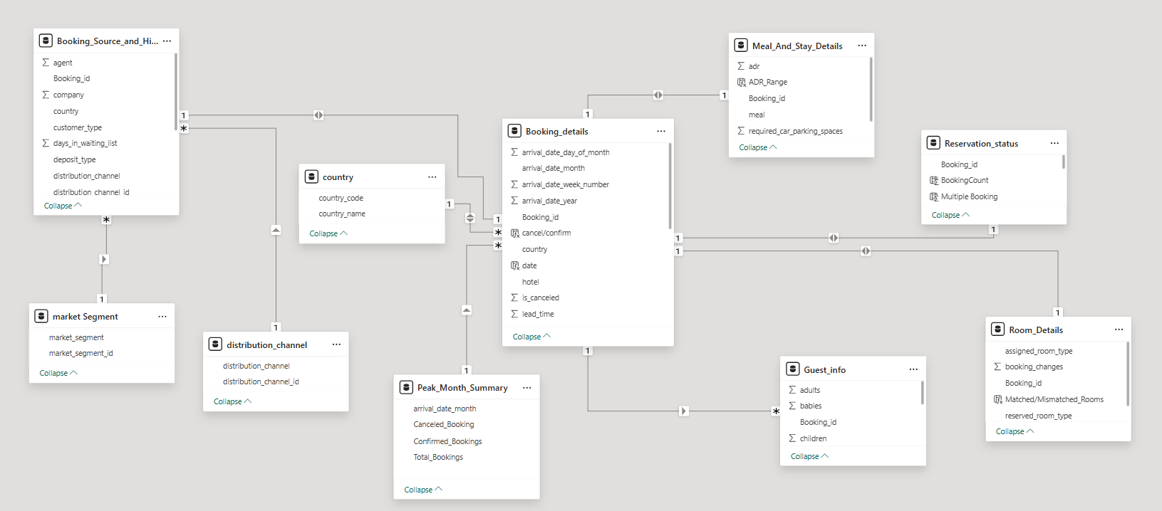
ER Diagram

Slide 10
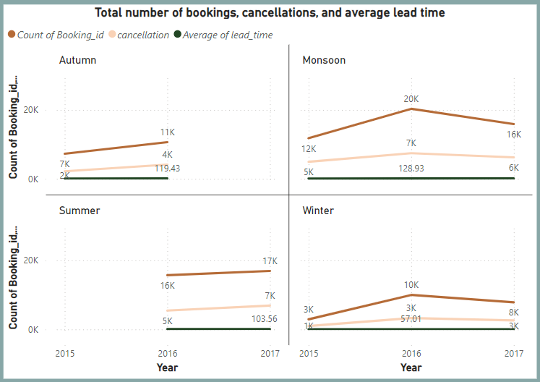
1. Visualize booking trends over the years, including the number of bookings, cancellations, and average lead time. Identify seasonality patterns.

Slide 11
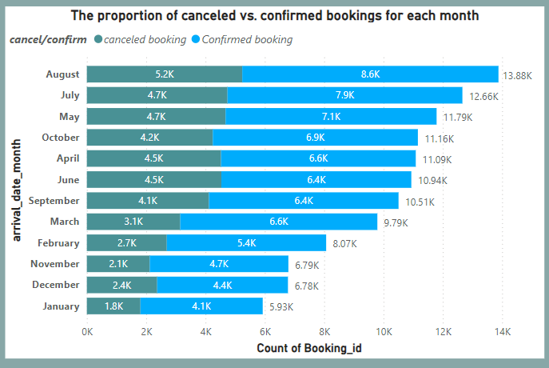
2. Analyze monthly booking patterns to identify peak months and optimize marketing strategies.

Slide 12
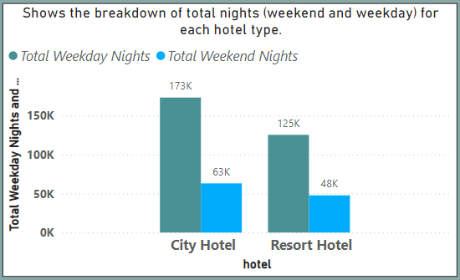
3. Compare stays in weekend nights and weekday nights to determine preferences and variations by hotel type.

Slide 13
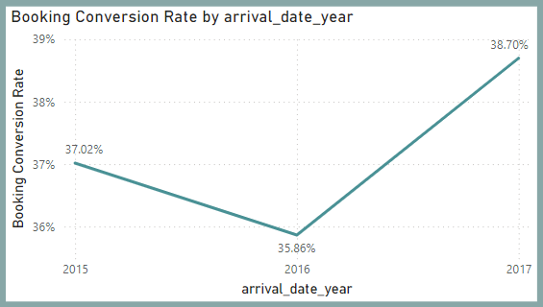
4. Calculate and visualize the booking conversion rate (canceled bookings to total bookings) over time.

Slide 14
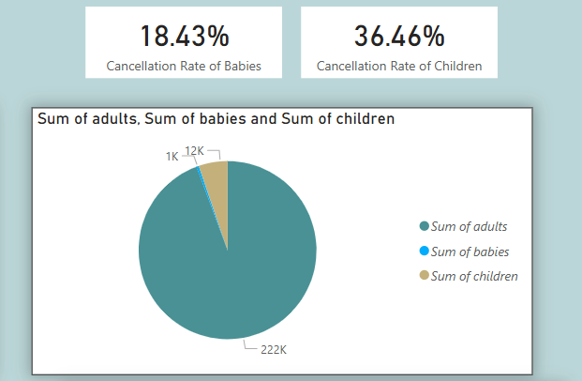
5. Visualize the distribution of adults, children, and babies in bookings. Explore the impact of children and babies on cancellation rates.

Slide 15
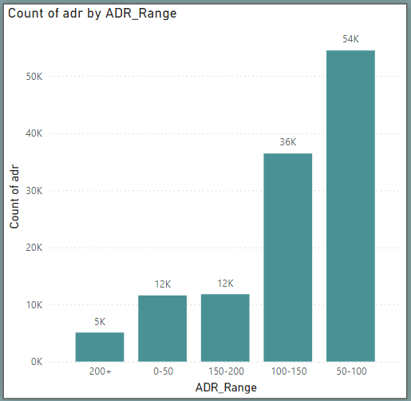
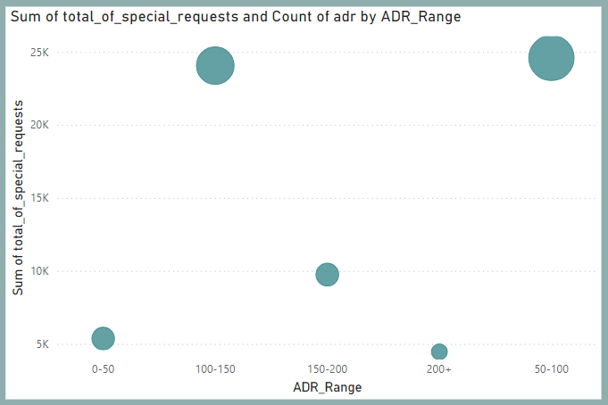
6. Analyze the distribution of Average Daily Rates (ADR) and identify correlations with the number of special requests made by guests.

Slide 16
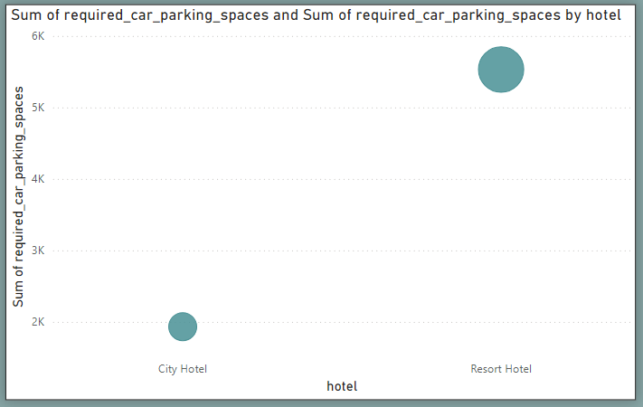
7. Visualize the relationship between the number of required car parking spaces and booking type (Resort Hotel vs City Hotel).

Slide 17
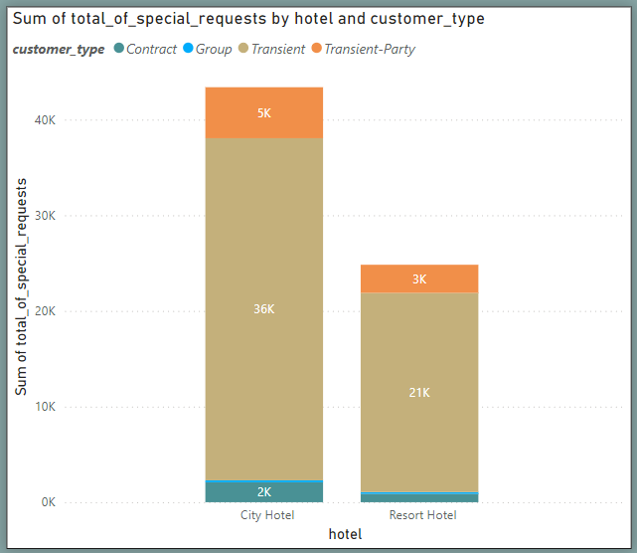
8. Use power BI to explore how the total number of special requests made by guests varies by hotel type and customer type (Transient, Group).

Slide 18
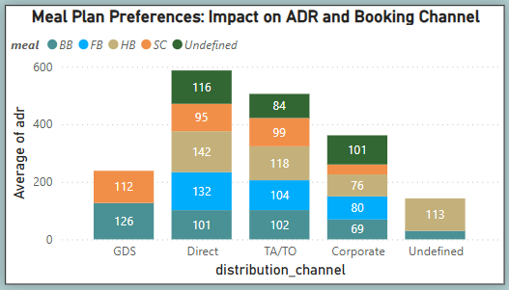
9. Explore meal plans and their impact on Average Daily Rates (ADR). Analyze meal plan preferences and their association with booking channels.

Slide 19
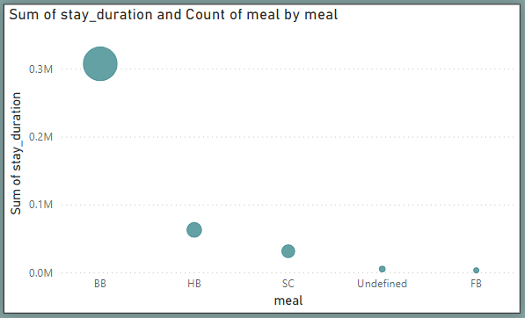
10. Analyze how meal plans correlate with stay duration and investigate any differences in stay lengths based on meal plans.

Slide 20
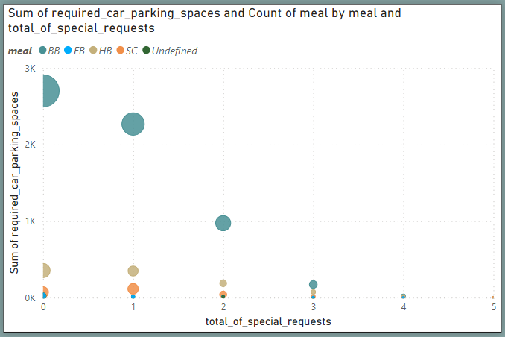
11. Correlate parking requirements and special requests with different meal plans. Determine if certain meal plans result in more requests or parking needs.

Slide 21
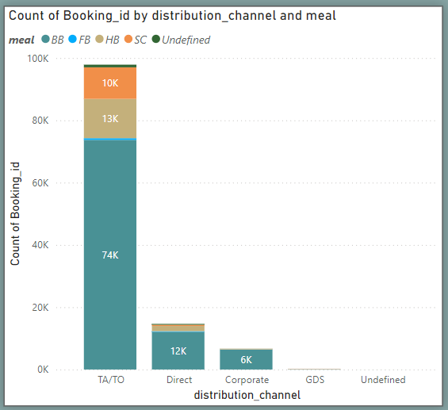
12. Explore how meal plans are distributed across various booking channels. Analyze if certain channels are associated with specific meal plans.

Slide 22
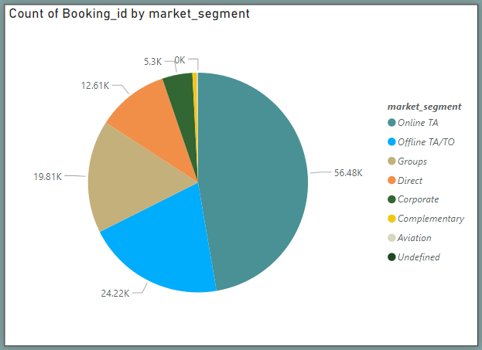
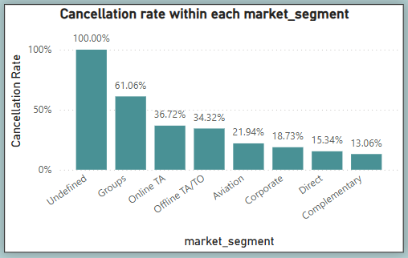
13. Visualize booking distribution across different market segments and analyze cancellation rates within each segment.

Slide 23
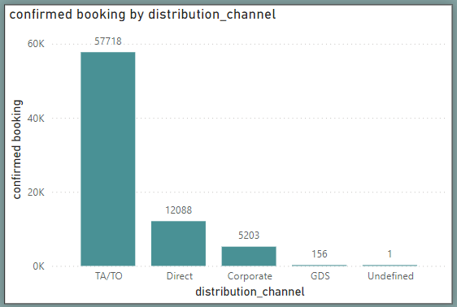
14. Compare the effectiveness of booking distribution channels in generating confirmed bookings. Identify the most commonly used channels by guests.

Slide 24
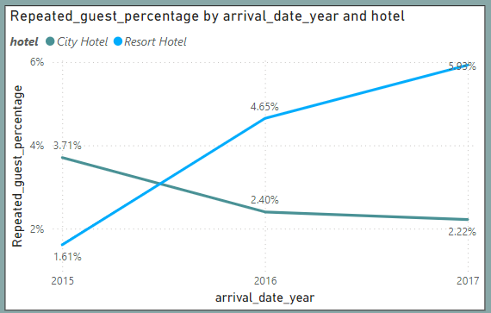
15. Visualize the percentage of repeated guests for each hotel type (Resort Hotel vs. City Hotel) over time. Explore factors influencing guest retention.

Slide 25
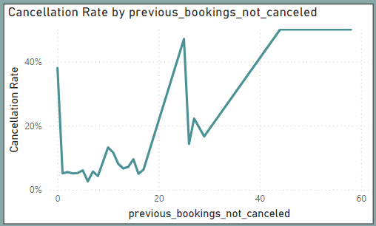
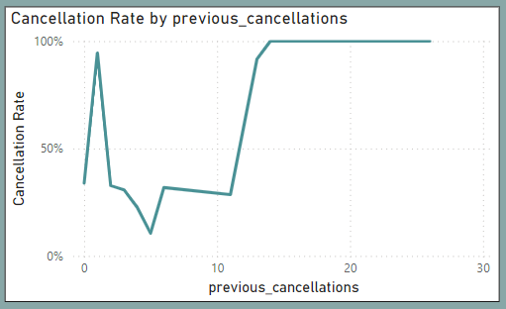
16. Analyze the impact of a guest's booking history (previous cancellations and noncancelled bookings) on their likelihood of cancelling a current booking.

Slide 26
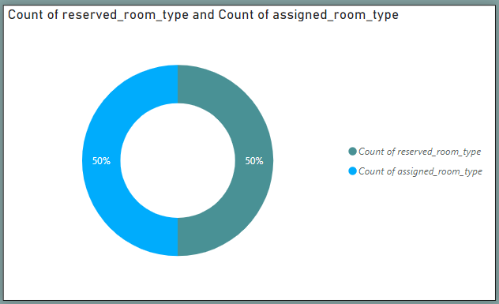
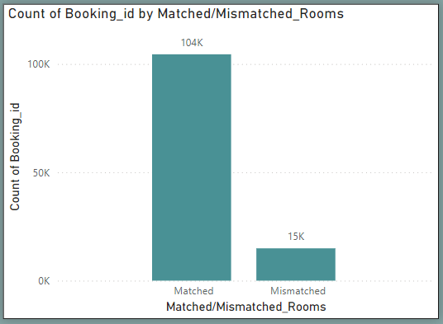
17. Visualize the distribution of reserved and assigned room types. Analyze whether guests tend to receive the room type they initially reserved.

Slide 27
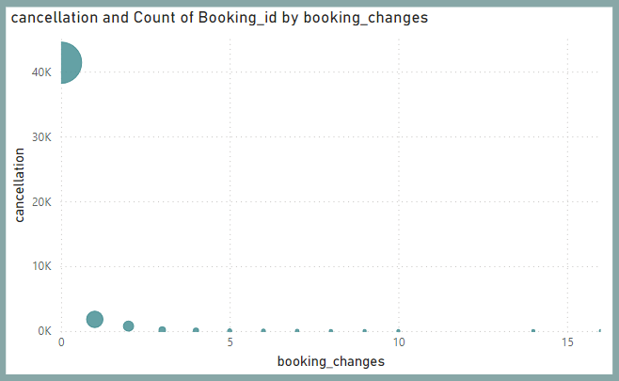
18. Investigate the relationship between the number of booking changes made by guests and their likelihood of cancelling a booking.

Slide 28
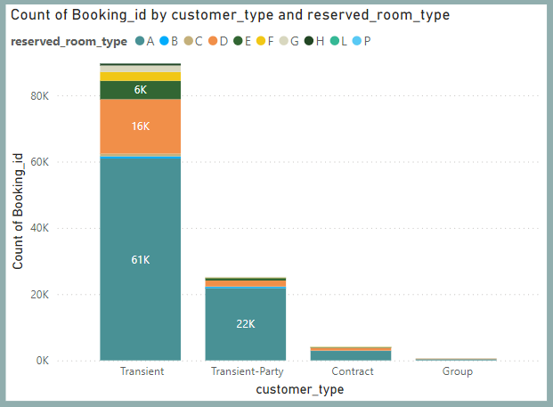
19. Analyze room type preferences based on customer types (e.g., Transient, Group) and identify any patterns in room type selection.

Slide 29
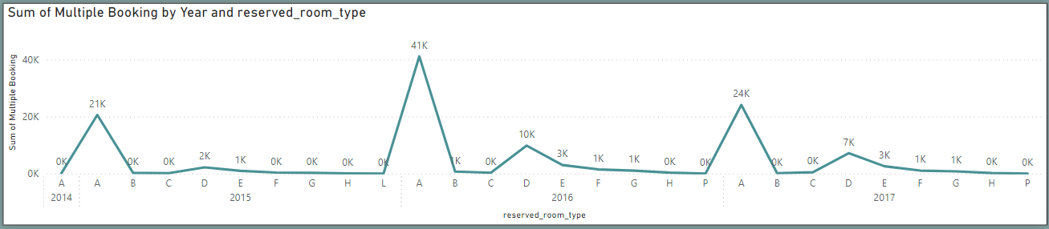
20. Analyze whether guests who make multiple bookings tend to consistently request the same room type or if their preferences change over time.

Slide 30
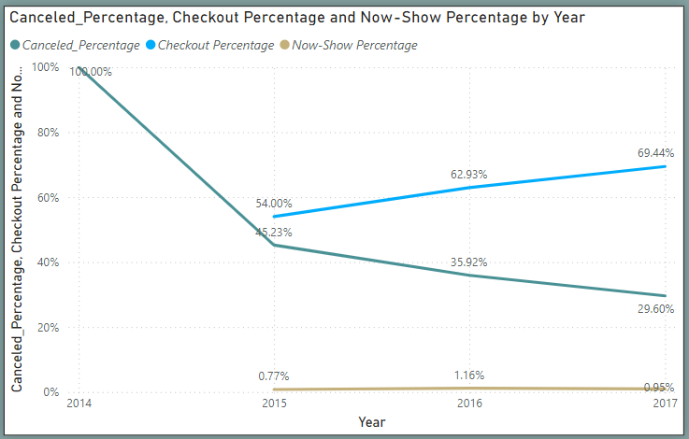
21. Provide an overview of reservation statuses over time, including the percentage of cancelled, checked out, and no show bookings.

Slide 31
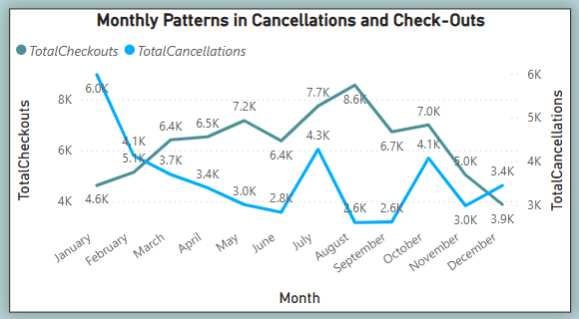
22. Analyze trends in reservation status dates, such as the busiest checkout dates or patterns in cancellations by month.

Slide 32
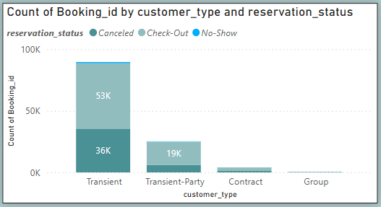
23. Visualize how reservation statuses vary across different customer types (e.g., Transient, Group) and identify if certain customer types are more likely to result in cancellations or no-show.

Slide 33
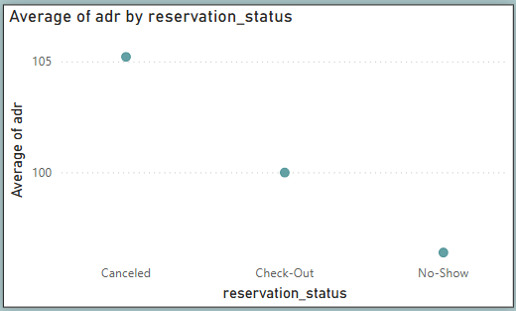
24. Explore the relationship between reservation statuses and Average Daily Rates (ADR) to determine if there are differences in ADR based on booking outcomes.

Slide 34
EDA
QUESTIONS

Slide 35
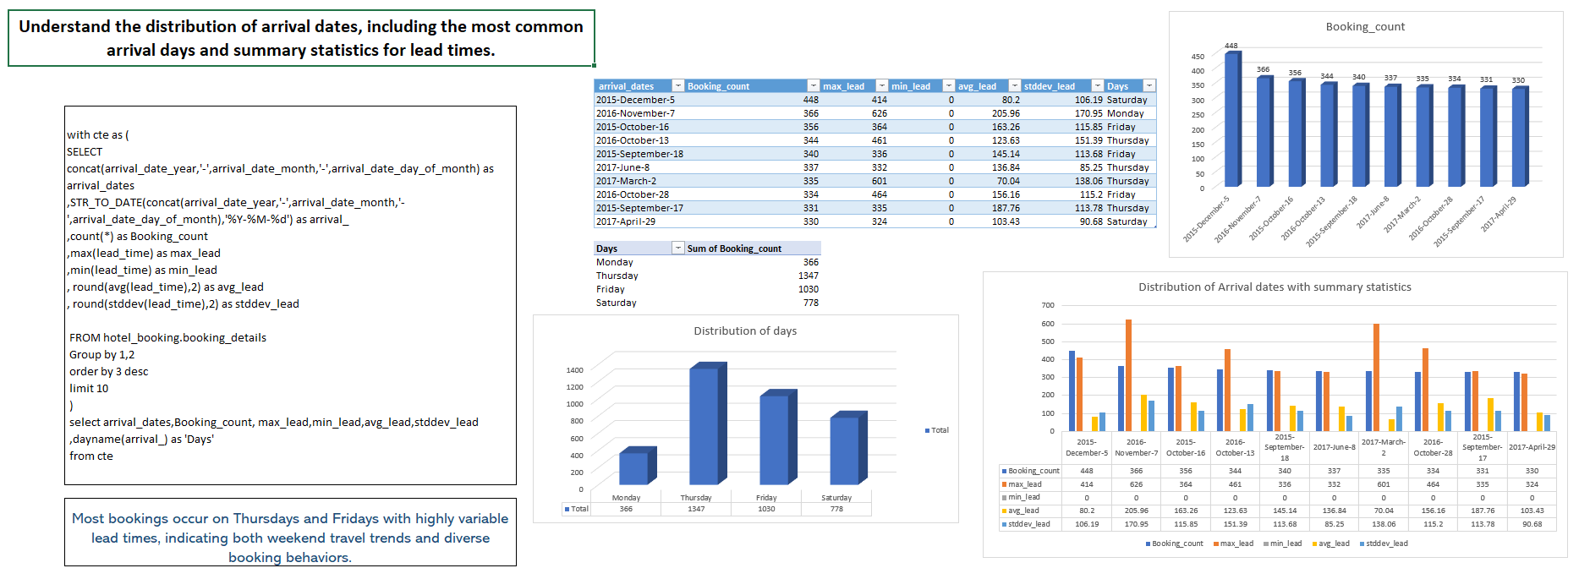

Slide 36
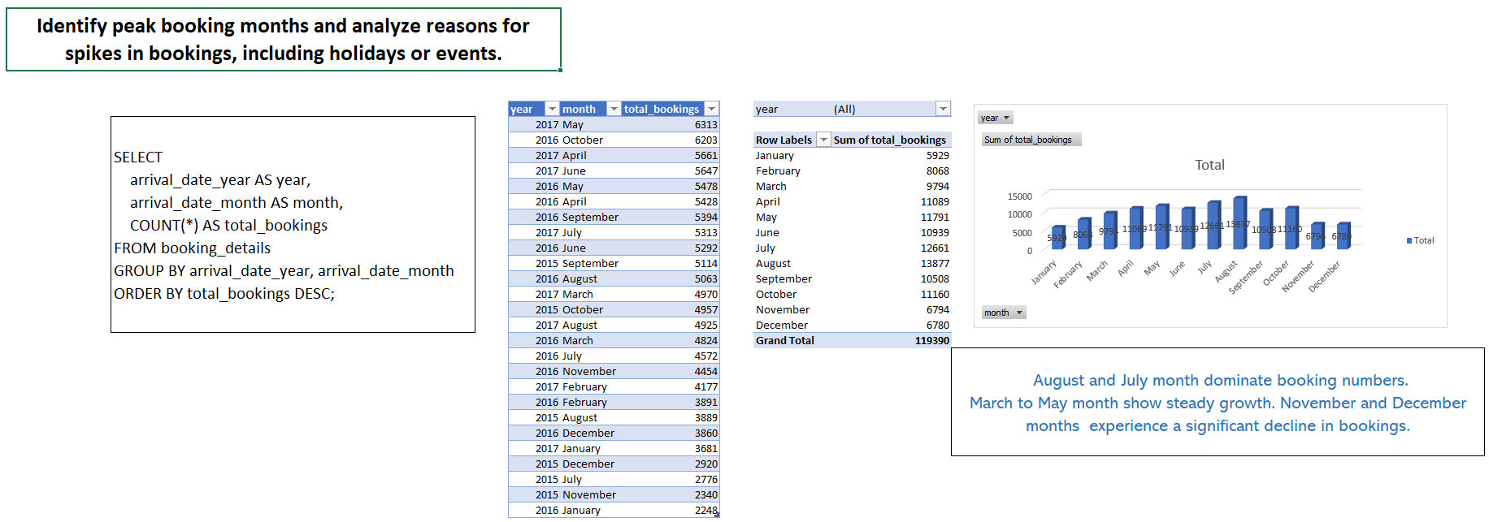

Slide 37
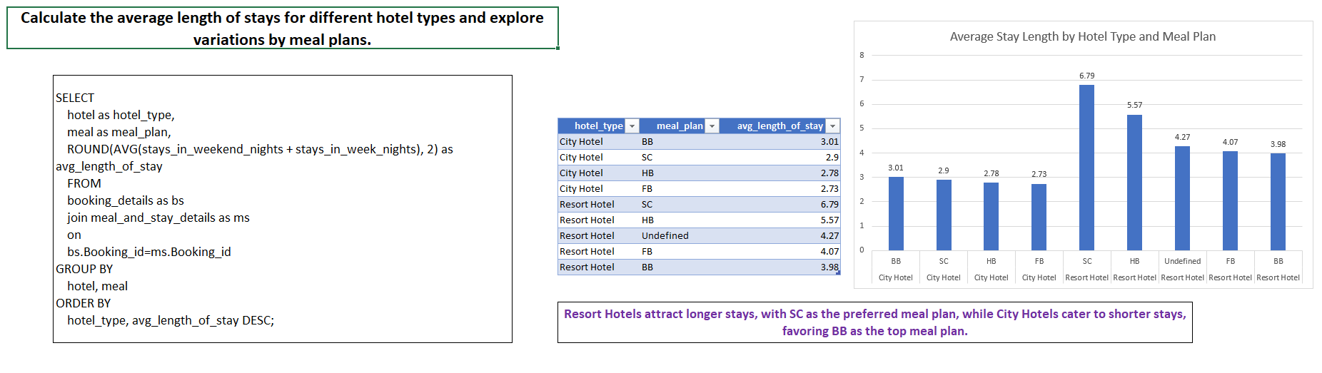

Slide 38
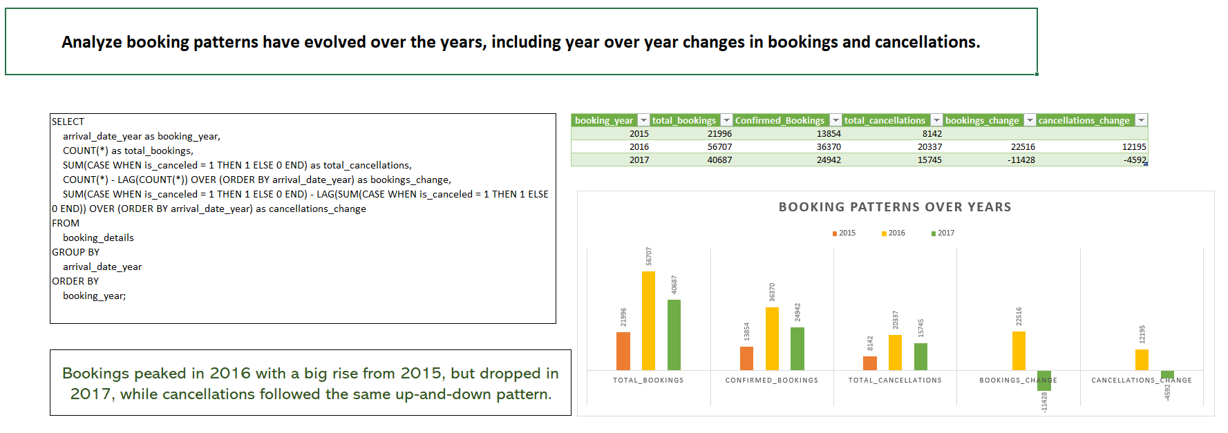

Slide 39
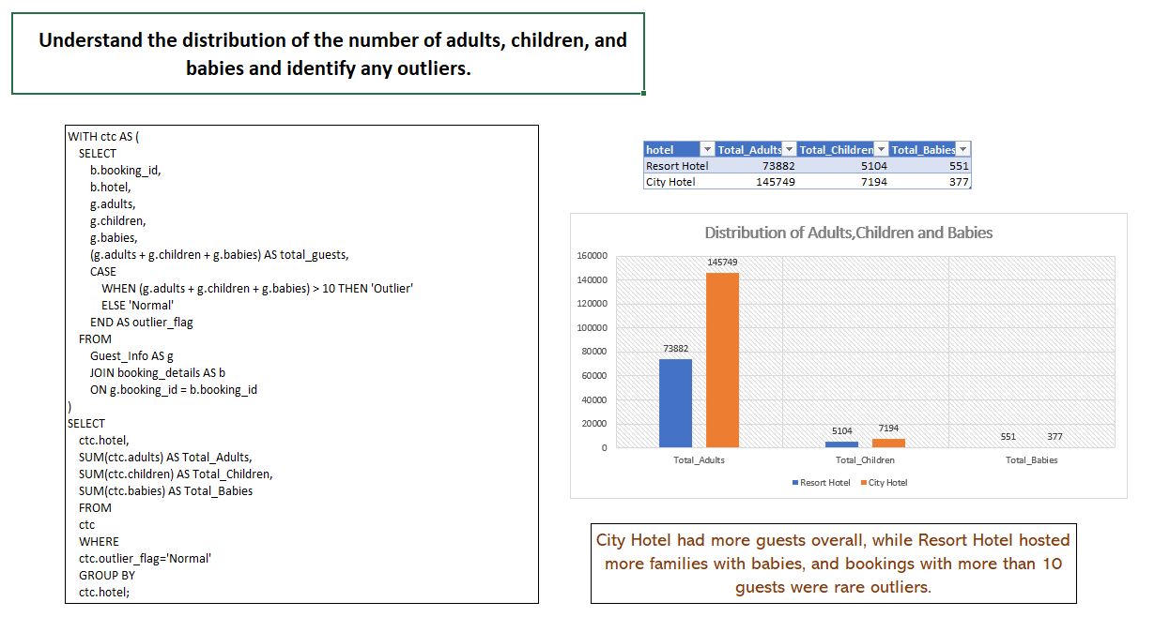

Slide 40
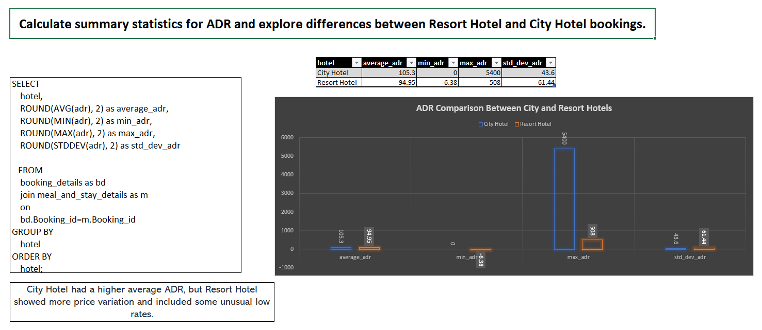

Slide 41
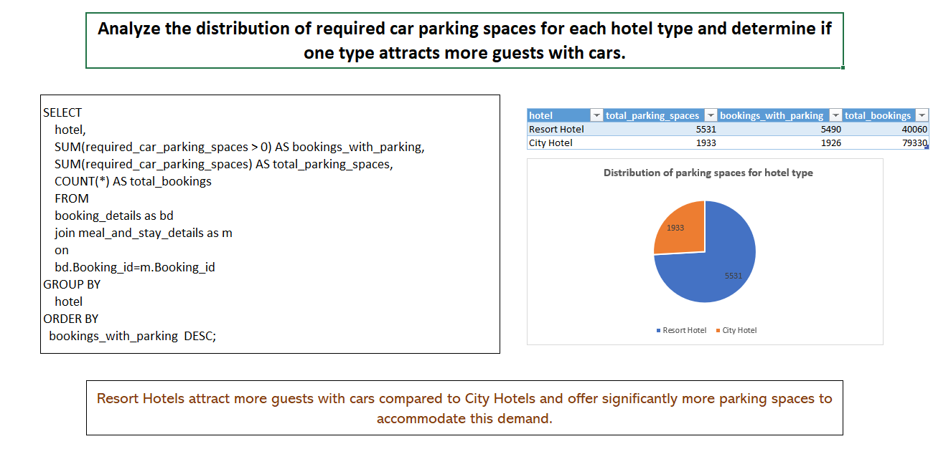

Slide 42
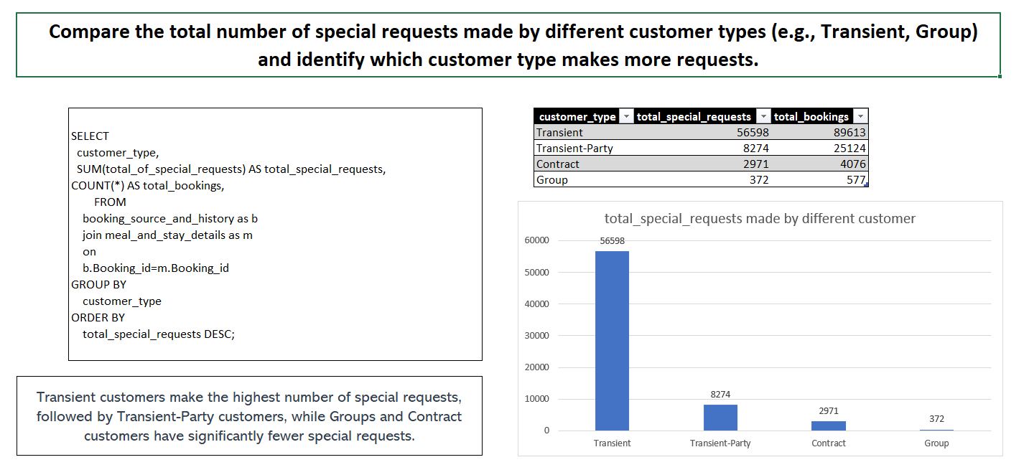

Slide 43
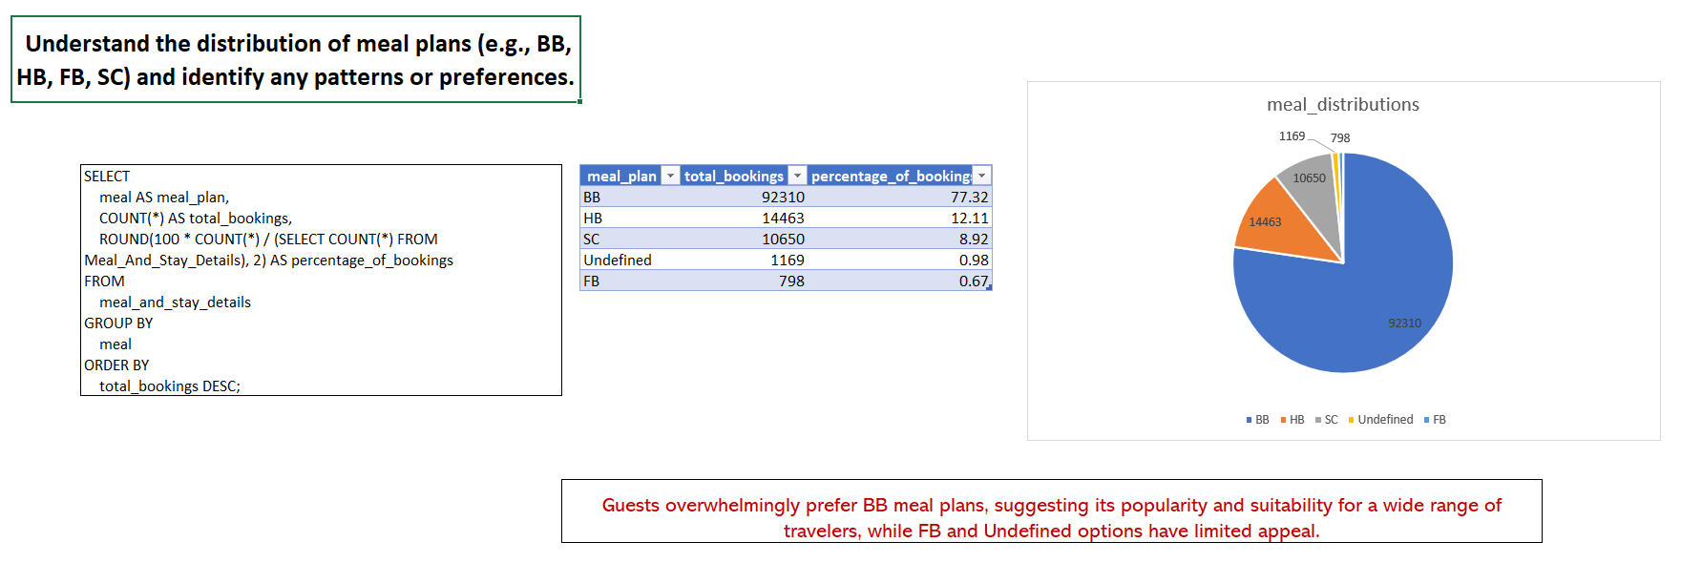

Slide 44
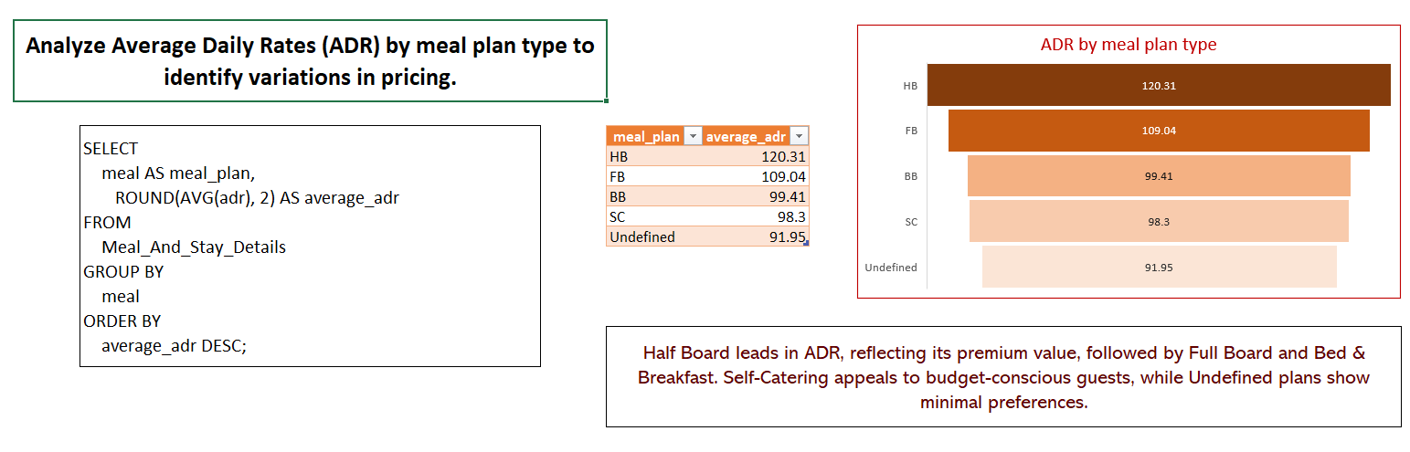

Slide 45
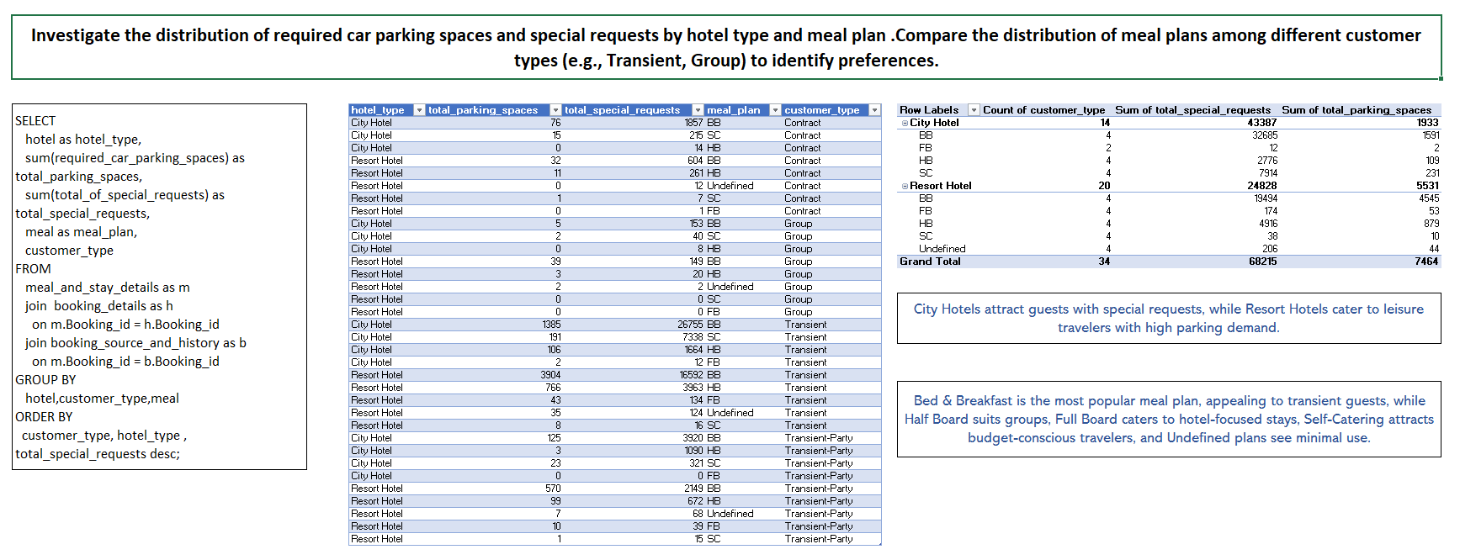

Slide 46
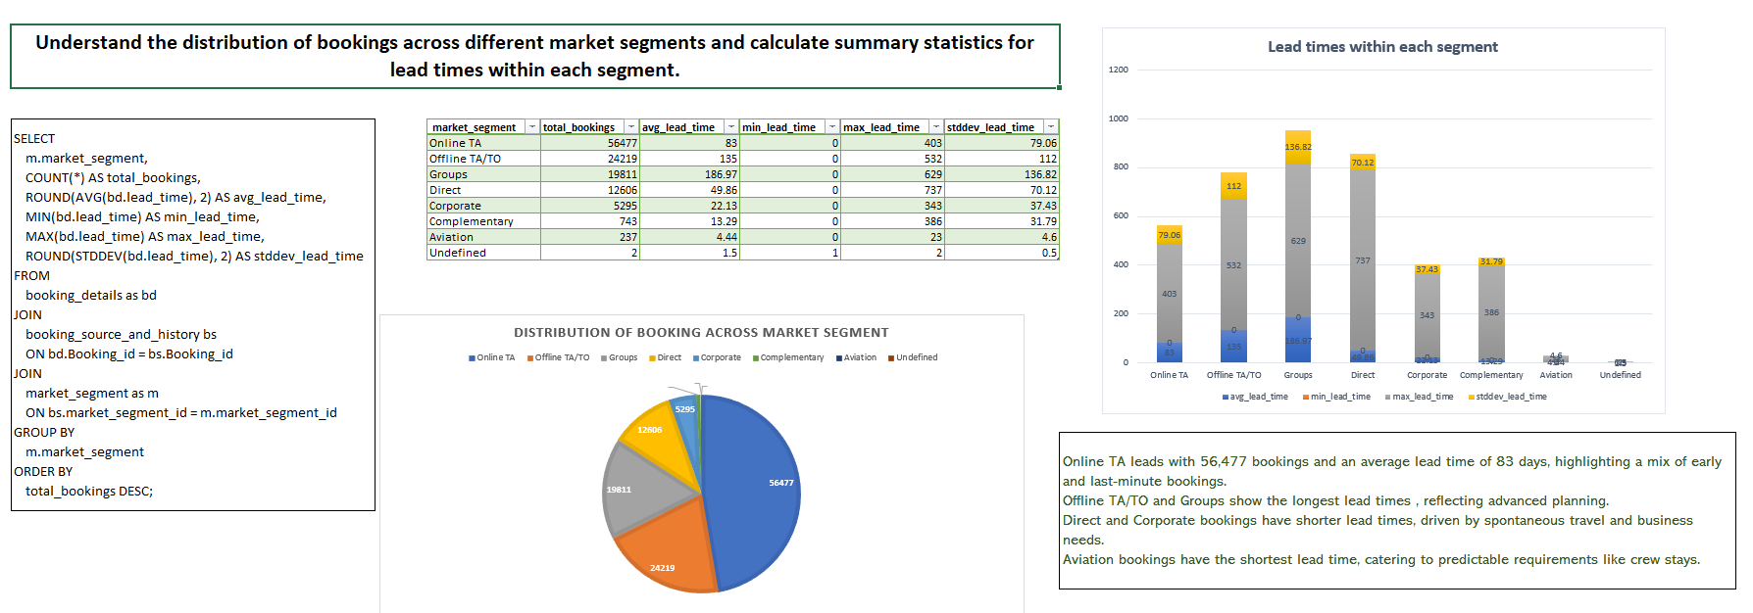

Slide 47
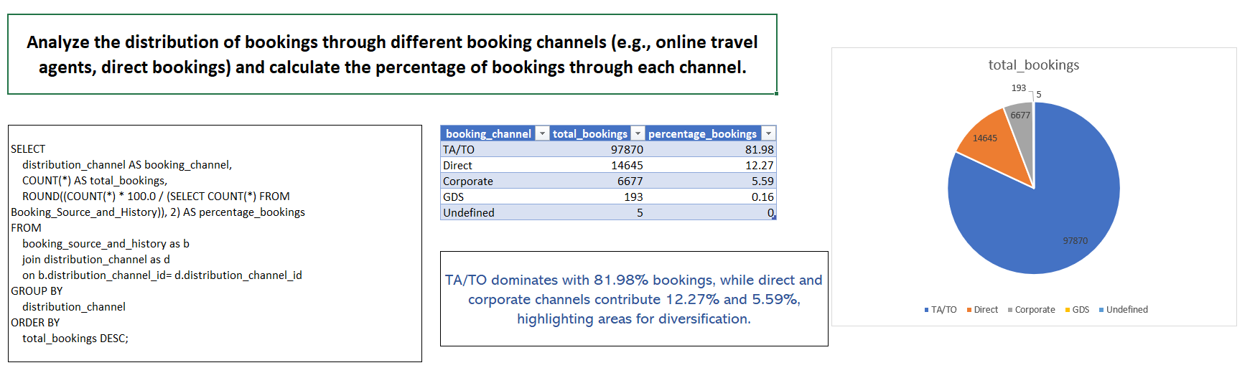

Slide 48
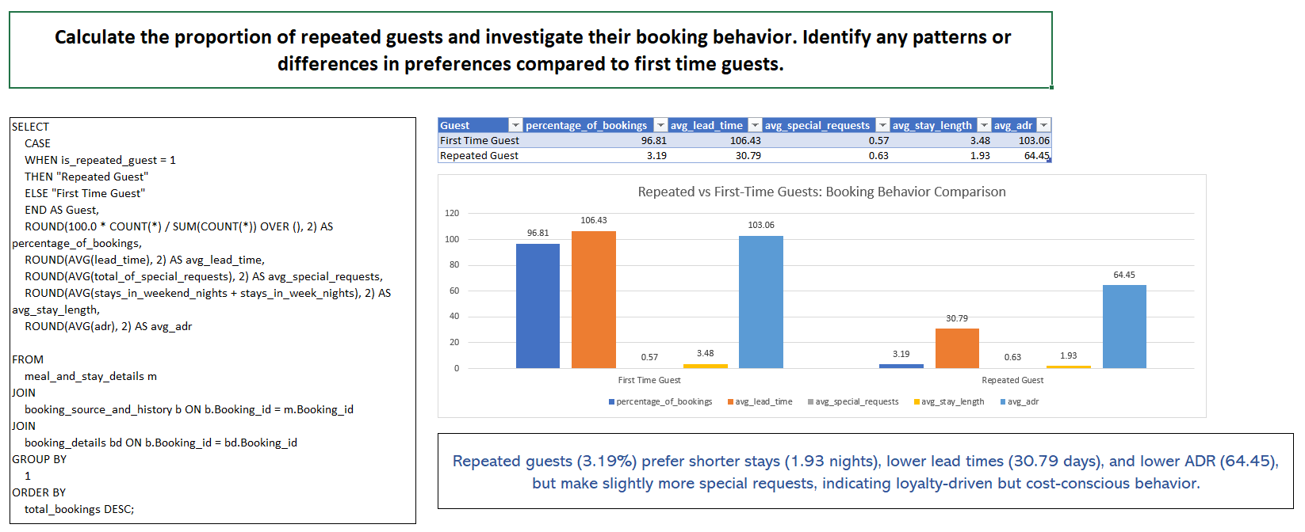

Slide 49
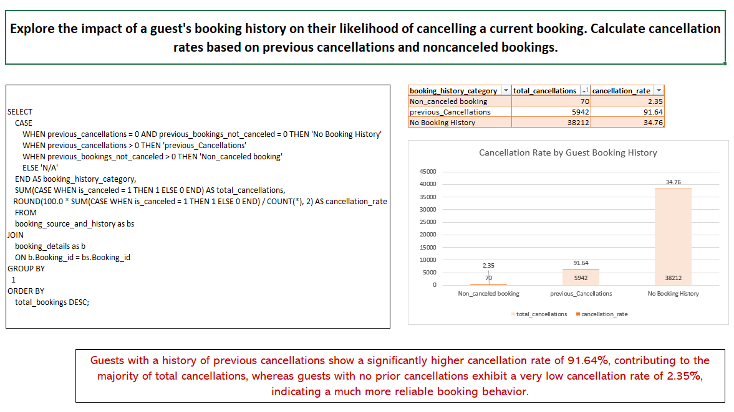

Slide 50
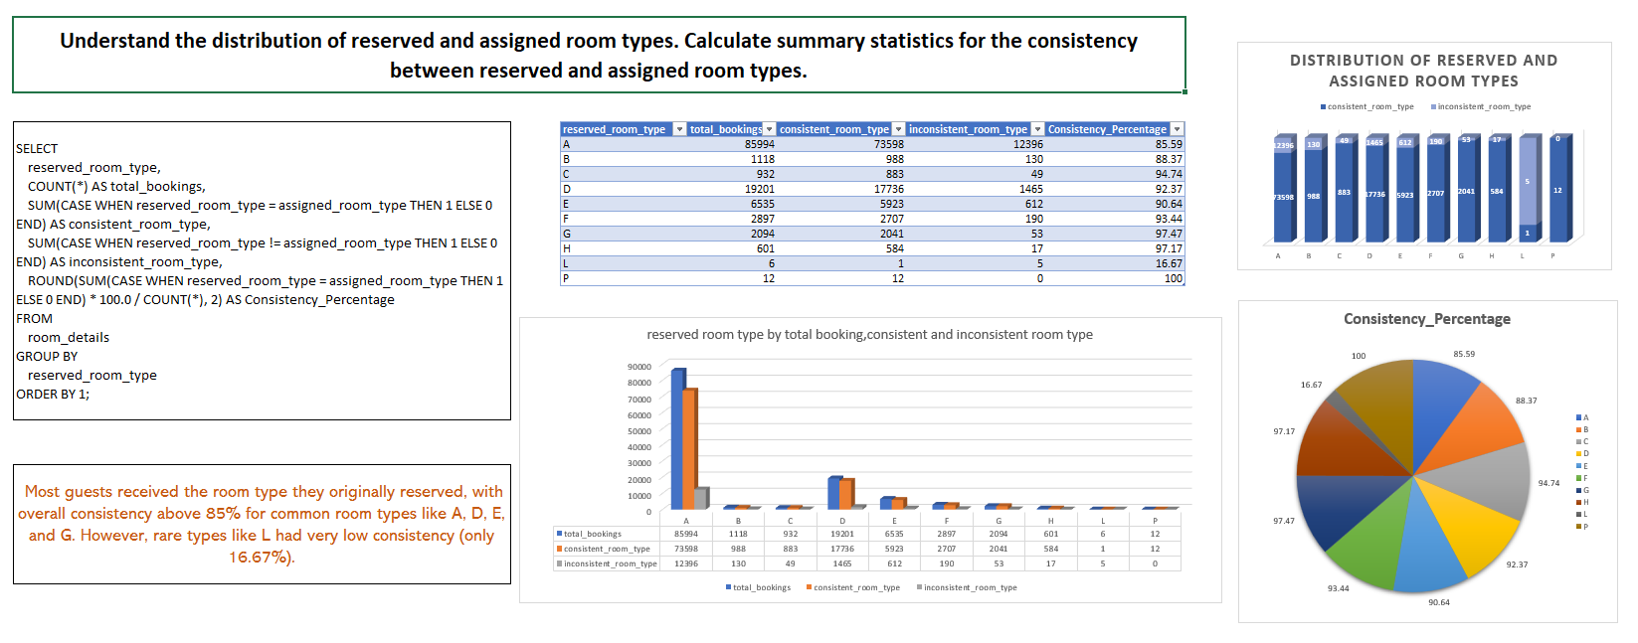

Slide 51
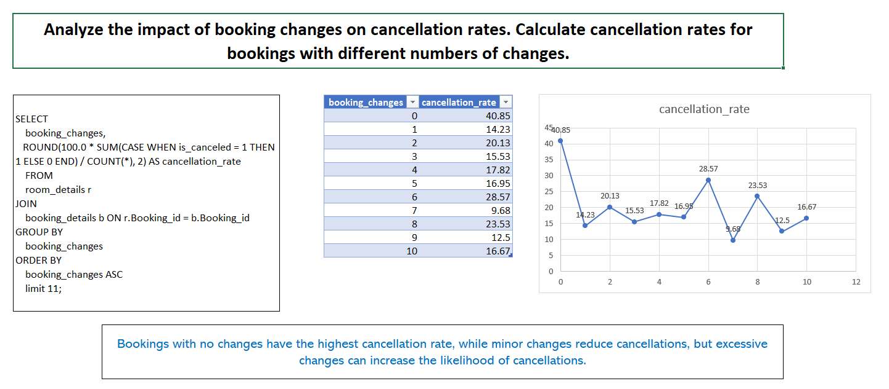

Slide 52
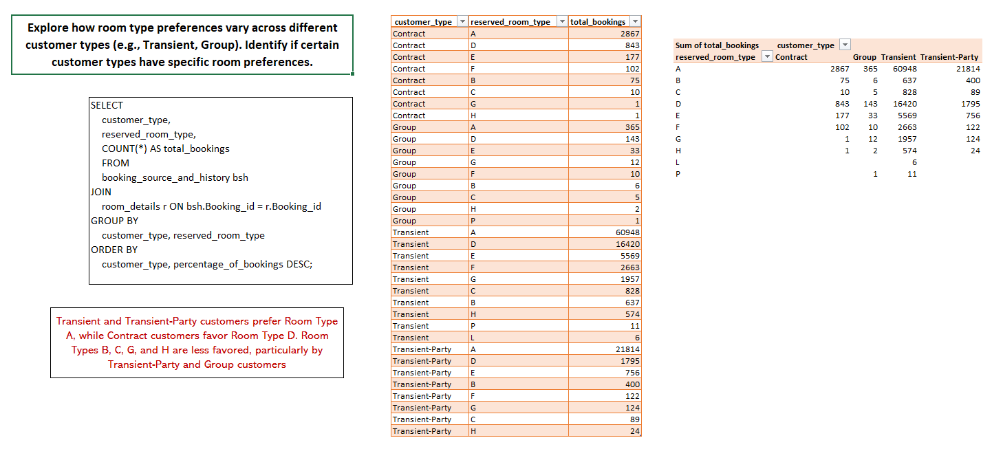

Slide 53
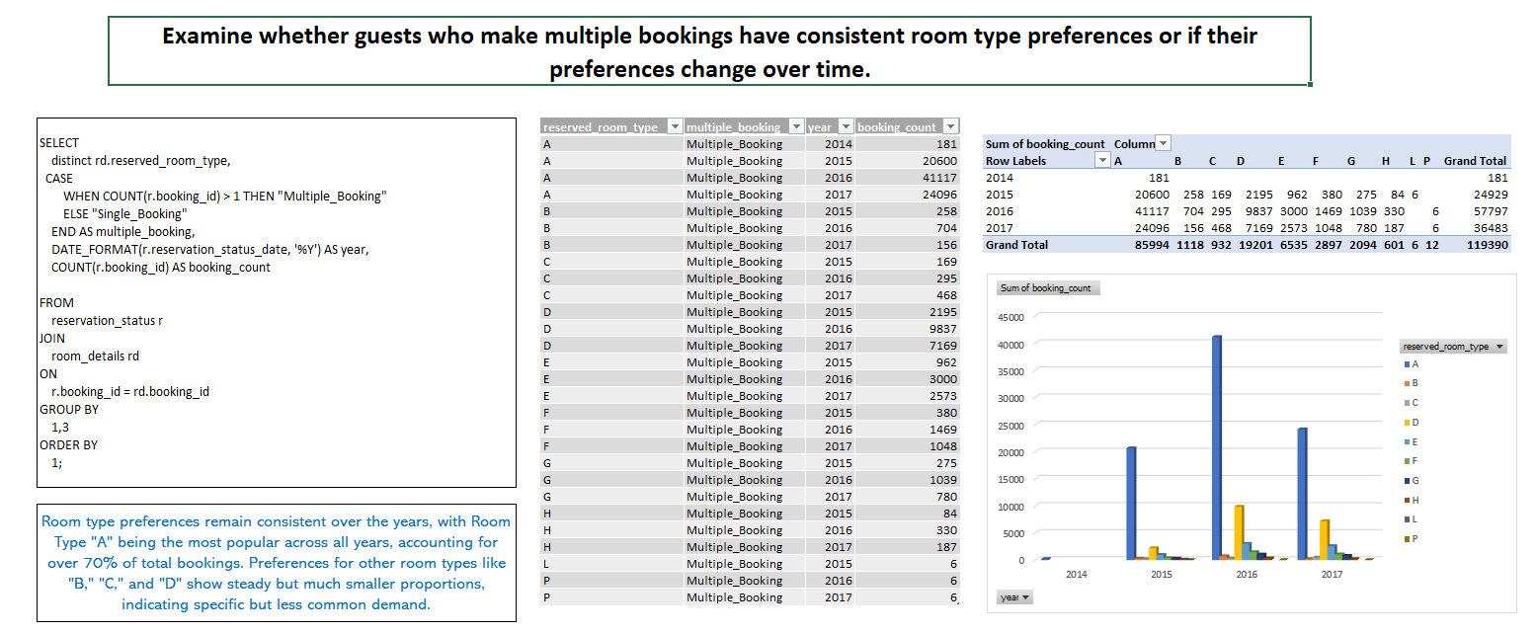

Slide 54


Slide 55


Slide 56


Slide 57


Slide 58

Layout Of Dashboard

Slide 59





Slide 60




Slide 61
Conclusion
This analysis provided key insights into booking trends, guest preferences, revenue patterns and operational challenges.
Monsoon and Summer seasons saw the highest bookings, while Winter had the lowest, suggesting opportunities for seasonal marketing.
The BB (Bed & Breakfast) meal plan and Room Type A were most preferred, especially for longer stays. Guests making frequent booking changes were more likely to cancel, indicating a need for better follow-up.
TA/TO channels brought the most bookings but had high cancellations. Direct and Corporate bookings were more stable and reliable.
The ₹50–100 ADR range was the most profitable, with high bookings and special requests.
City Hotels attracted short-stay business travelers, while Resort Hotels saw longer stays and better guest retention.
These findings support data-driven strategies to improve guest satisfaction and boost hotel revenue.

Slide 62
Thank you

